Slide 1


DAFS-FT-09
Behind the Stream :
Analyzing Netflix’s catalogue
Allombert Jean-Baptiste

Slide 2


Slide 3


Dataset :
This Dataset uses the Netflix Titles Dataset, which includes information about TV-Shows and Movies available on Netflix.
Key columns :
title: The name of the movie/TV-show.
type: Whether the title is a movie or a TV-show.
cast: The actors involved in the title.
release_year: The year the title was released.
genre: Genres associated with the title.
https://www.kaggle.com/datasets/shivamb/netflix-shows

Slide 4
Objectives
Identify the most represented genres.
Quantify Netflix’s presence across countries.
Determine which country has the largest catalogue.
Analyze seasonality in content release.

Slide 5
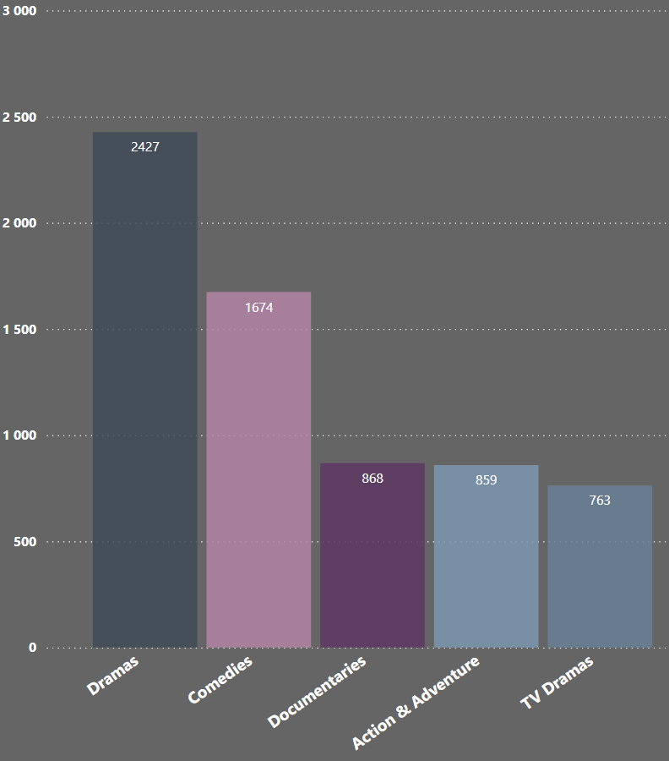
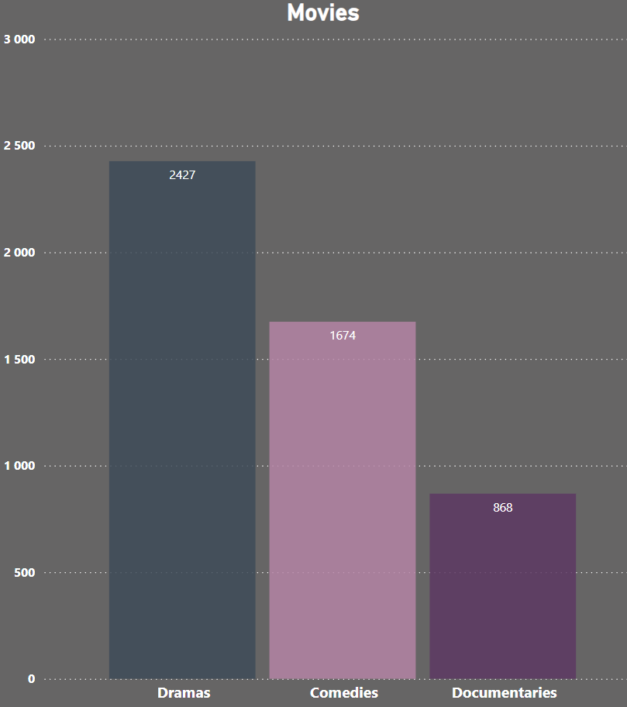
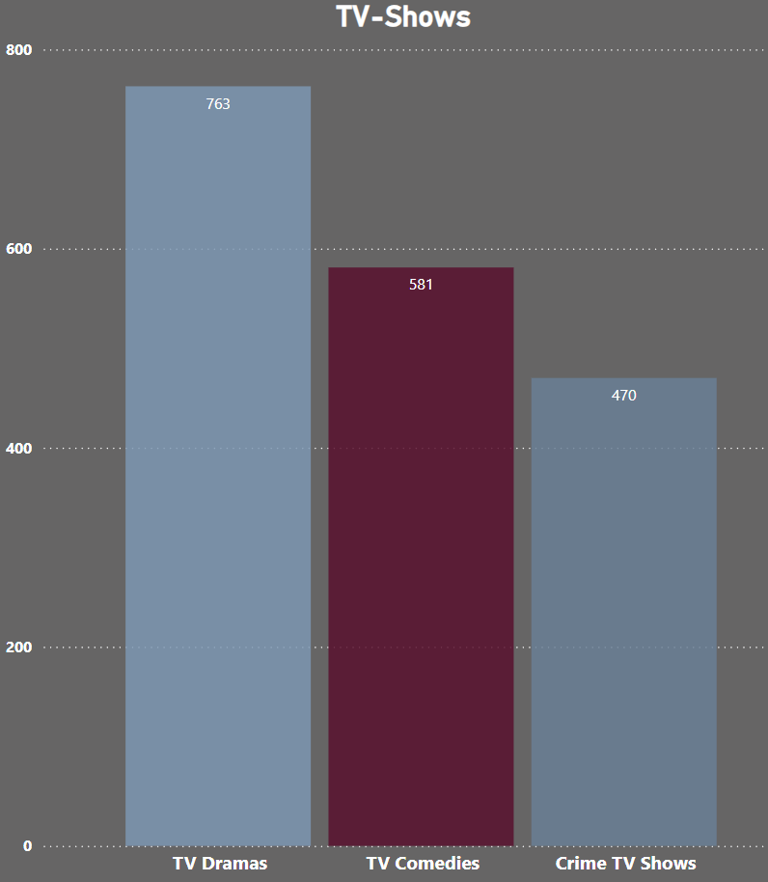
Exploring Netflix’s most popular genres

Slide 6
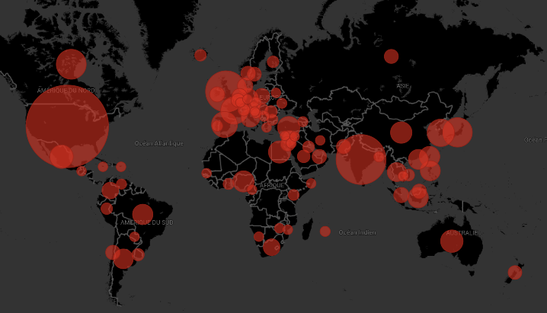
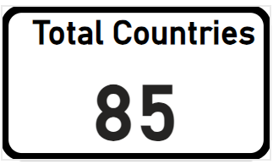
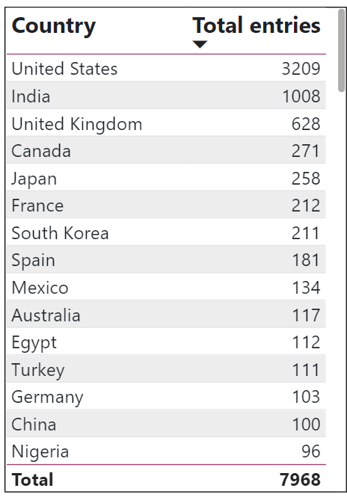
Worldwide distribution of Netflix’s catalogue

Slide 7
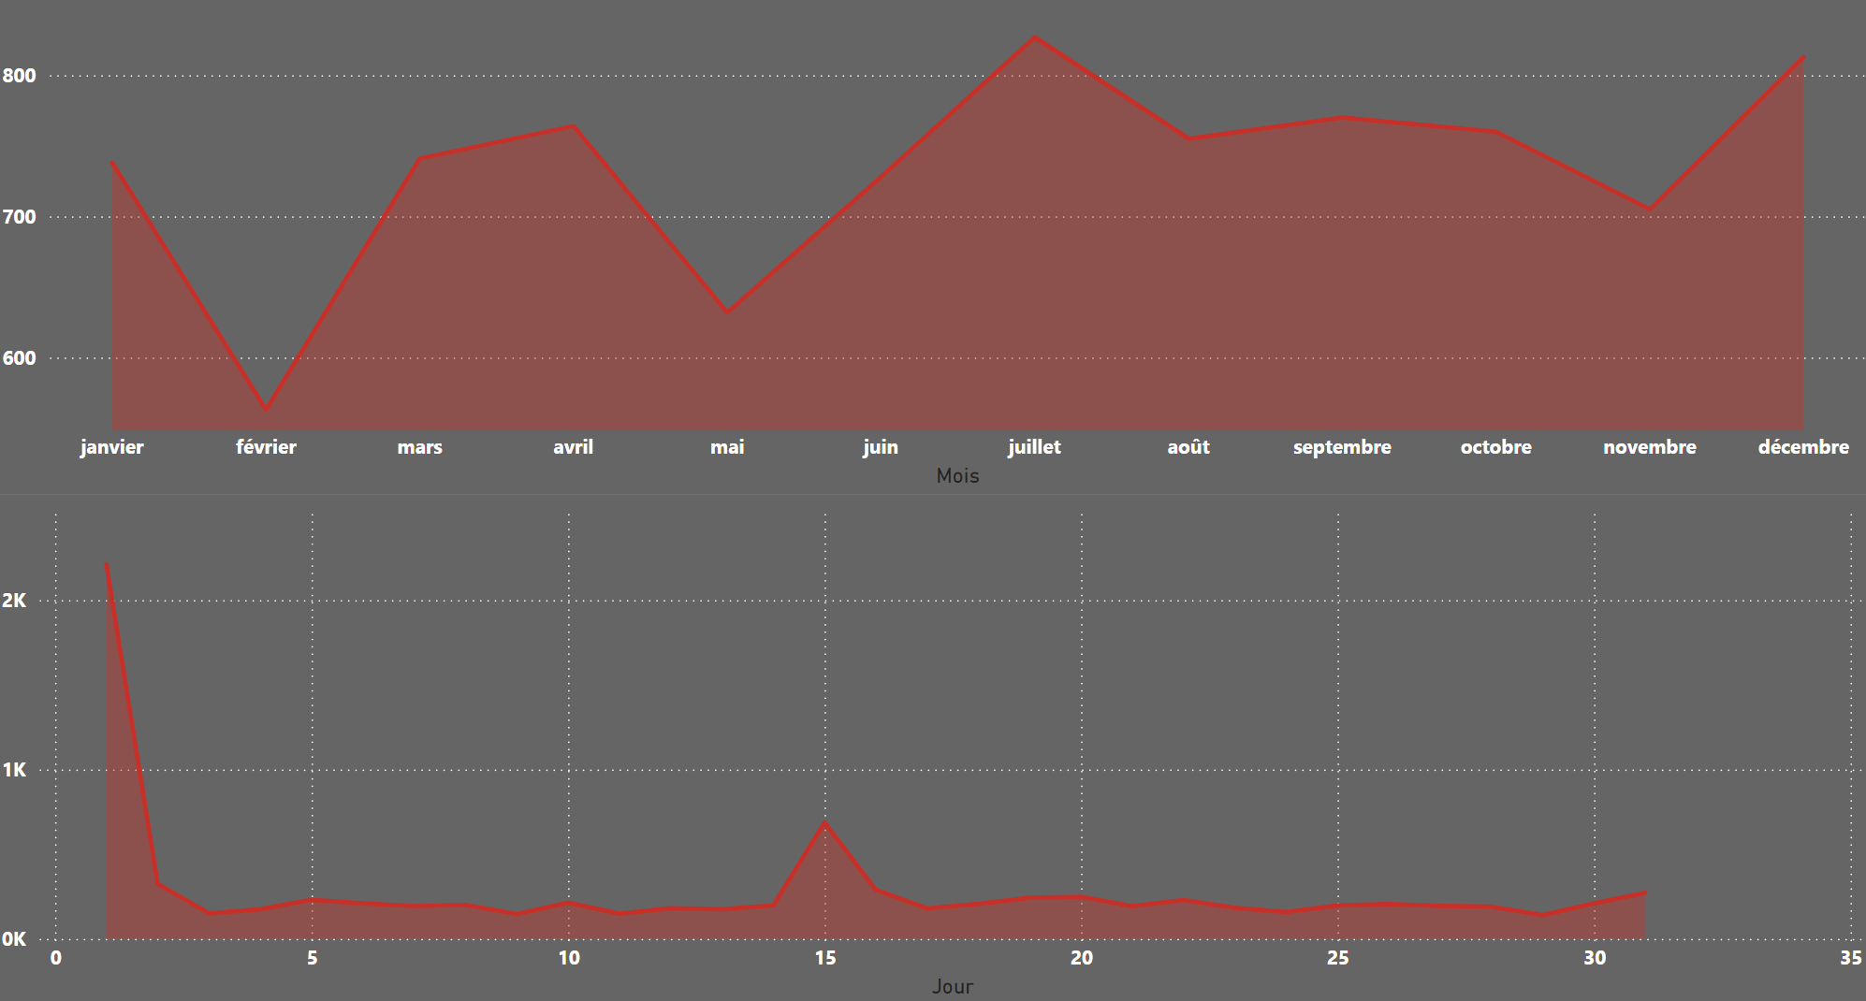
Seasonality release

Slide 8
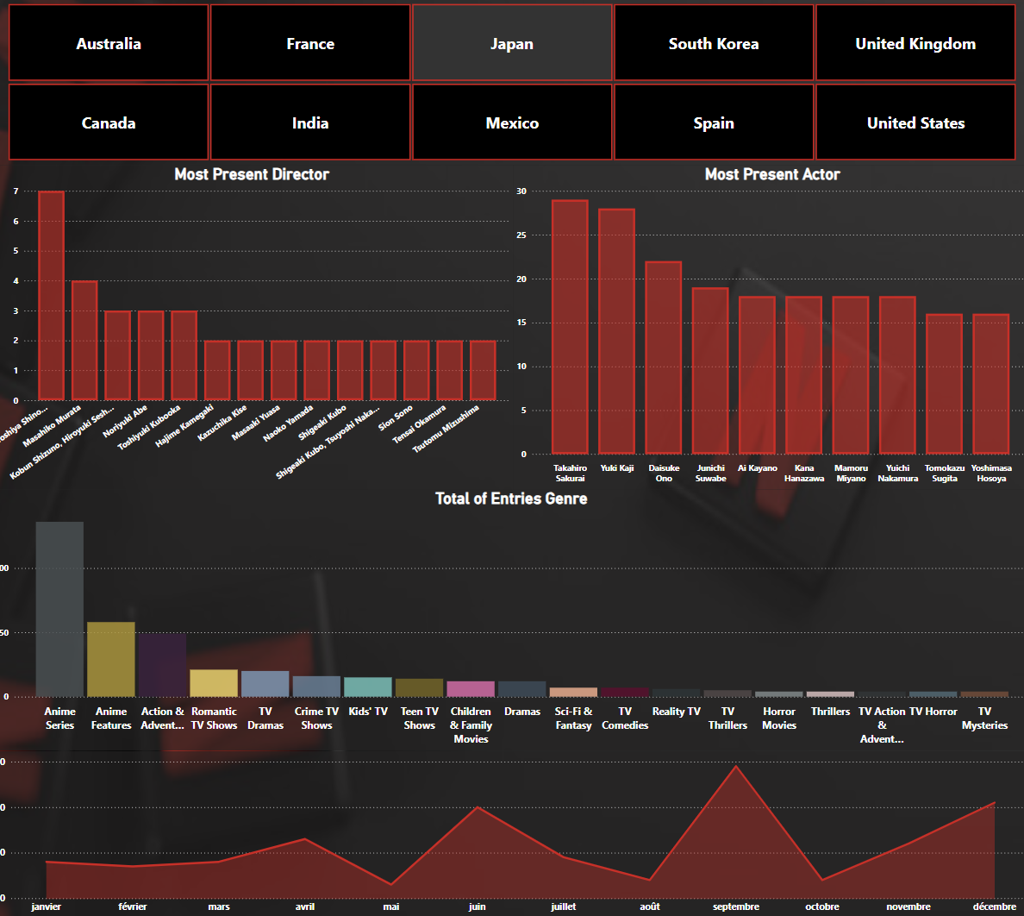
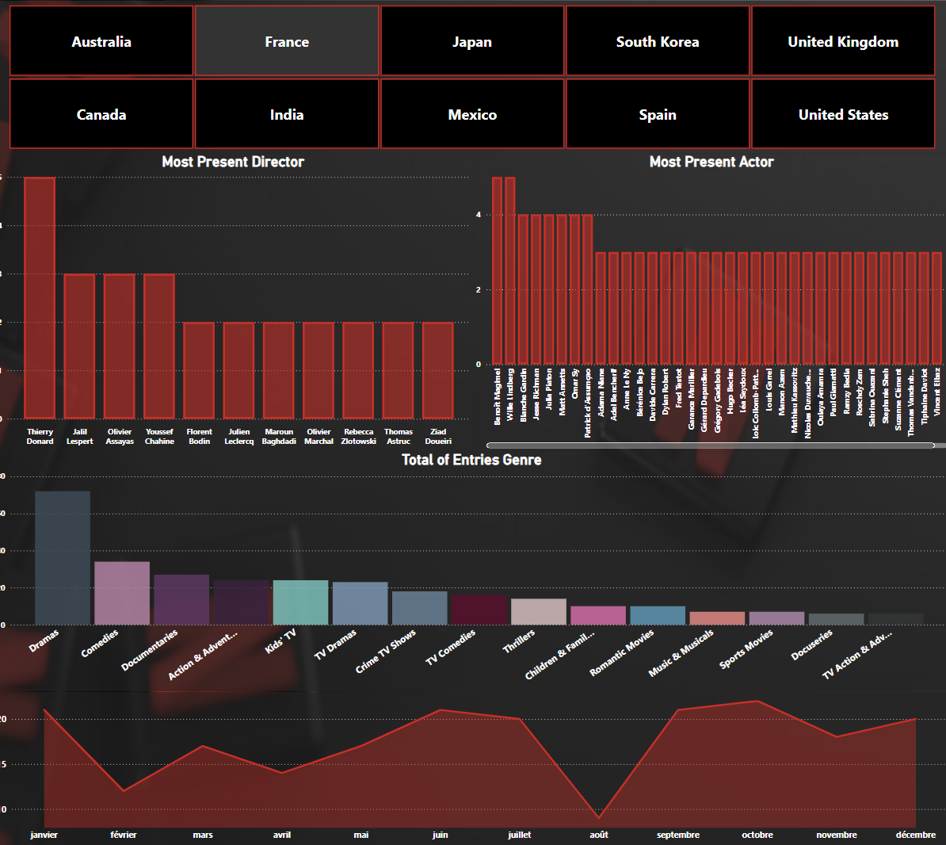
From Paris to Tokyo: Contrasting trends

Slide 9
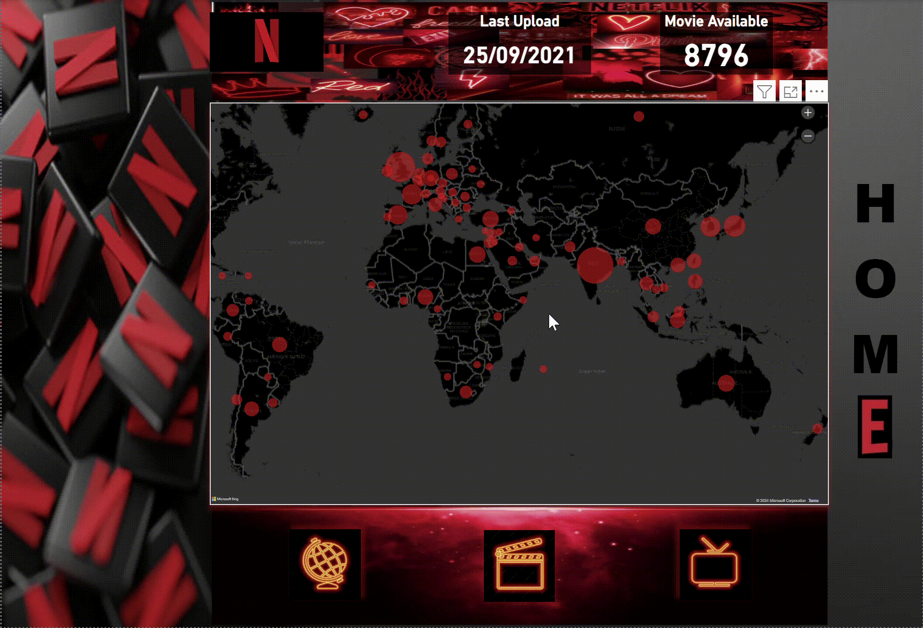

Slide 10
Future Improvements
Analyze user watch time by hour/day.
Integrate real-time data for dynamic dashboard.
Add revenue and subscription trend analysis.

Slide 11
Conclusion
As expected, the US hosts the most extensive library.
Certain genres are more popular in specific countries.
Content additions peak at the end of the year, aligning with holiday seasons.
Netflix is available in over 190 countries.

Slide 12

Thank You

Slide 13


Any questions ?

